Slide 1


Advanced Computer Architecture Fall 2020
Hamed Farbeh
farbeh@aut.ac.ir
Department of Computer Engineering
Amirkabir University of Technology
Lecture 5

Slide 2
Copyright Notice
Lectures adopted from
Computer Architecture: A Quantitative Approach, 5th edition, John L. Hennessy,‎ David A. Patterson, MK pub., 2019
Advanced Computer Architecture-Fall 2020, AUT, Tehran, Iran

Slide 3
Computer Architecture
A Quantitative Approach, Sixth Edition
Chapter 3
Instruction-Level Parallelism and Its Exploitation

Slide 4
Hardware-Based Speculation
Execute instructions along predicted execution paths but only commit the results if prediction was correct
Instruction commit: allowing an instruction to update the register file when instruction is no longer speculative
Need an additional piece of hardware to prevent any irrevocable action until an instruction commits
I.e. updating state or taking an execution
Hardware-Based Speculation

Slide 5
Reorder Buffer
Reorder buffer – holds the result of instruction between completion and commit
Four fields:
Instruction type: branch/store/register
Destination field: register number
Value field: output value
Ready field: completed execution?
Modify reservation stations:
Operand source is now reorder buffer instead of functional unit
Hardware-Based Speculation

Slide 6

Reorder Buffer
Issue:
Allocate RS and ROB, read available operands
Execute:
Begin execution when operand values are available
Write result:
Write result and ROB tag on CDB
Commit:
When ROB reaches head of ROB, update register
When a mispredicted branch reaches head of ROB, discard all entries
Hardware-Based Speculation

Slide 7
Reorder Buffer
Register values and memory values are not written until an instruction commits
On misprediction:
Speculated entries in ROB are cleared
Exceptions:
Not recognized until it is ready to commit
Hardware-Based Speculation

Slide 8
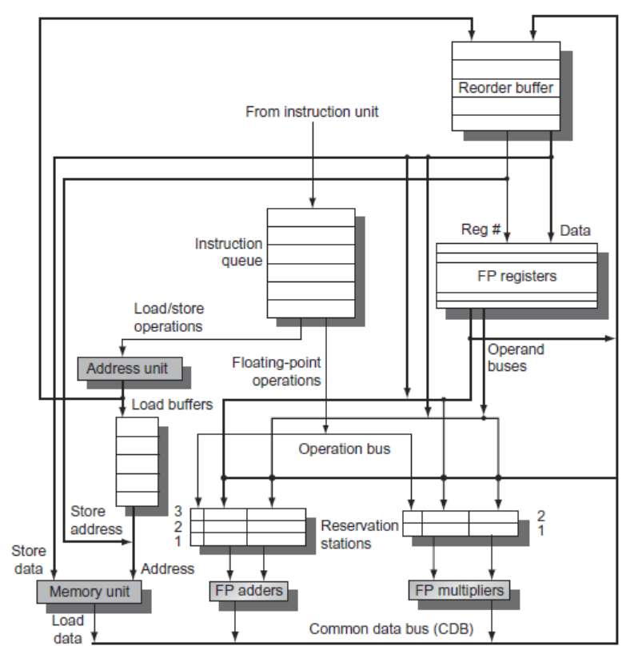
Reorder Buffer
Hardware-Based Speculation

Slide 9
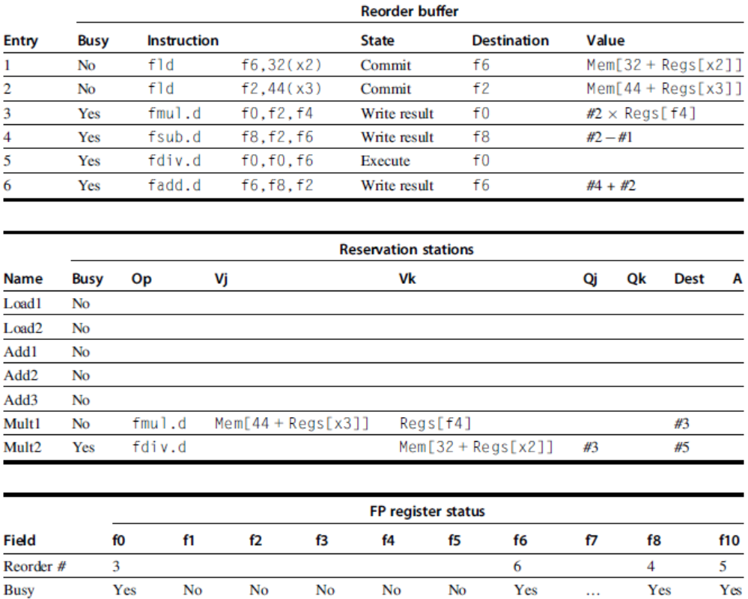
Reorder Buffer
Hardware-Based Speculation

